Slide 1
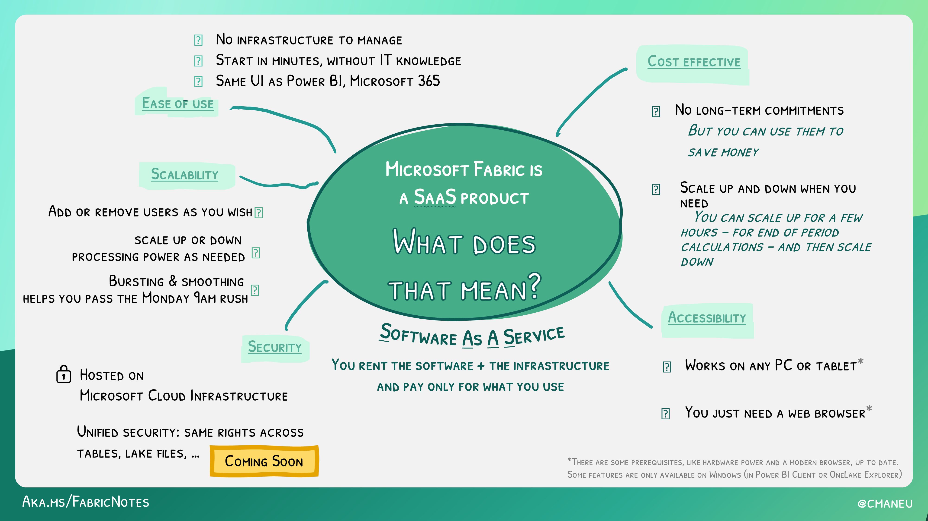

Slide 2














You
You
Azure
Azure
You
Azure

Slide 3



Microsoft Fabric
Sessão 1 Visão Geral 360 graus
Armando Lacerda
Azure Cloud Architect Independent Consultant
Tiago Balabuch
Cloud Solutions Architect
Notes:
Both

Slide 4

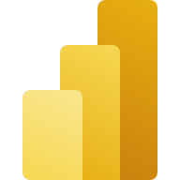


PaaS
SaaS
SaaS
You
You
You
Azure
Azure
Azure
Notes:
Armando

Slide 5





Ease of use
Scalability
SaaS
Security
You
Cost Effective
Azure
Accessibility
Notes:
Tiago

Slide 6







Data Lake
Data Factory
Data Warehouse
Databricks
Machine Learning
Data Explorer
Stream Analytics
Power BI
Notes:
Armando

Slide 7
Data Lake
Data Factory
Data Warehouse
Databricks
Machine Learning
Data Explorer
Stream Analytics
Power BI
Notes:
Armando

Slide 8

Data Lake
Data Factory
Data Warehouse
Spark Pool
Machine Learning
Data Explorer
Stream Analytics
Power BI
Notes:
Armando

Slide 9







OneLake
Data Factory
Data Warehouse
Data Engineering
Data Science
Real Time Analytics
Data Activator
Power BI

Slide 10
OneLake
Notes:
Armando – Storage Acct, then Tiago on OneLake

Slide 11
OneLake
Data Factory
Notes:
Tiago on Azure Data Factory, then Armando on Fabric Dat Factory

Slide 12
OneLake
Data Factory
Data Warehouse
Notes:
Armando on Synapse Dedicated SQL Pool and Serverless SQL Pool, then Tiago on Fabric Data Warehouse

Slide 13
OneLake
Data Factory
Data Warehouse
Data Engineering
Notes:
Tiago on Databricks notebooks and Synapse Spark Notebooks, then Armando on Fabric Data Engineer

Slide 14
OneLake
Data Factory
Data Warehouse
Data Engineering
Data Science
Notes:
Armando on Azure Machine Learning, then Tiago on Fabric Data Science

Slide 15
OneLake
Data Factory
Data Warehouse
Data Engineering
Data Science
Real Time Analytics
Notes:
Tiago on Azure Data Explorer, then Armando on Realtime Analytics

Slide 16
OneLake
Data Factory
Data Warehouse
Data Engineering
Data Science
Real Time Analytics
Stream Analytics
Notes:
Armando on Stream Analytics, then Tiago on Data Activator

Slide 17
OneLake
Data Factory
Data Warehouse
Data Engineering
Data Science
Real Time Analytics
Data Activator
Notes:
Tiago on Data Activator

Slide 18
OneLake
Data Factory
Data Warehouse
Data Engineering
Data Science
Real Time Analytics
Data Activator
Power BI
Notes:
Tiago on Power BI

Slide 19
Resumindo ...
Notes:
Armando

Slide 20
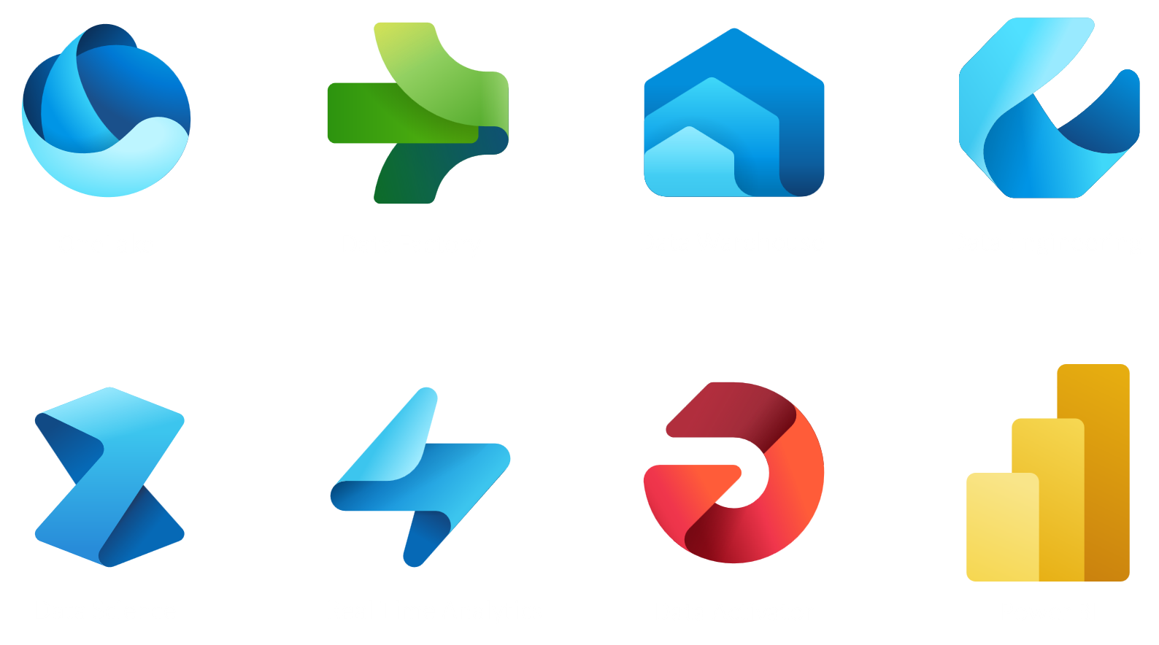
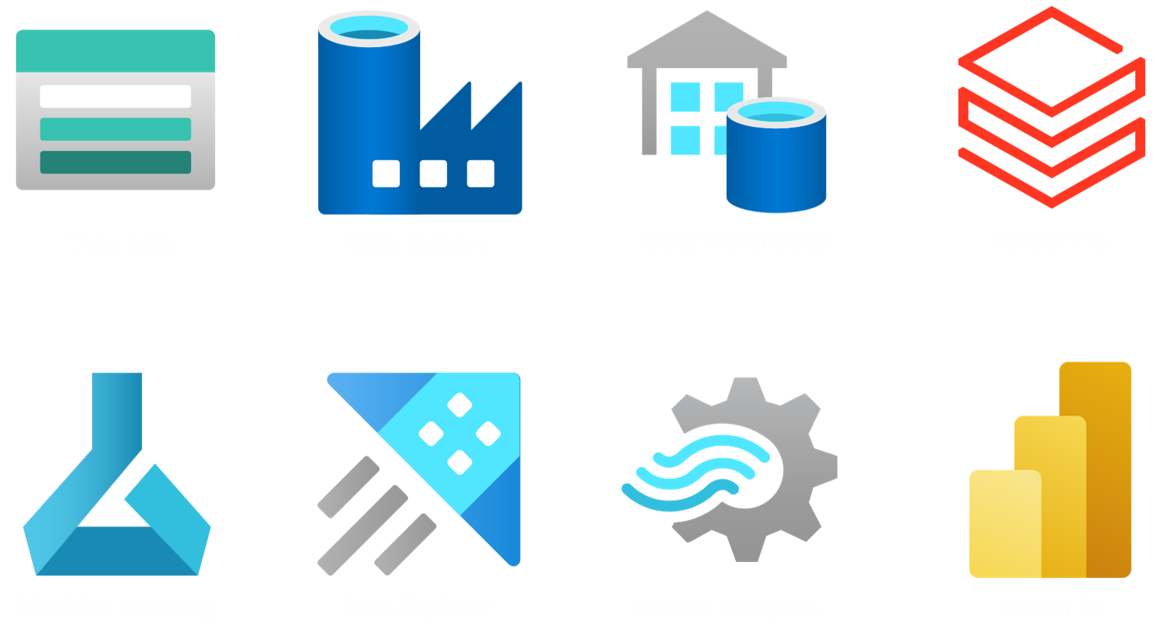
Notes:
Armando

Slide 21
Notes:
Armando

Slide 22
Nos vemos na próxima sessão.
Armando Lacerda
Azure Cloud Architect Independent Consultant
Tiago Balabuch
Cloud Solutions Architect
Notes:
Armando and Tiago

